Slide 1
Mental
Health
Initiative
By ASB, PALs, and NAMI, supported by administration and counseling

Slide 2
Why are we doing this?
Abrupt return back to full-time school & big adjustment
Results of Healthy Kids Survey
Recent events that have made students feel unsafe and or stressed out on school campus have increased the need for mental health resources to be available to students
Lack of knowledge about the mental health resources available to students our campus

Slide 3
How Our Initiative works
ASB Mental Health Initiative
Pals Support
School Social Worker
Psychologist
Support groups
NAMI
Counselors

Slide 4
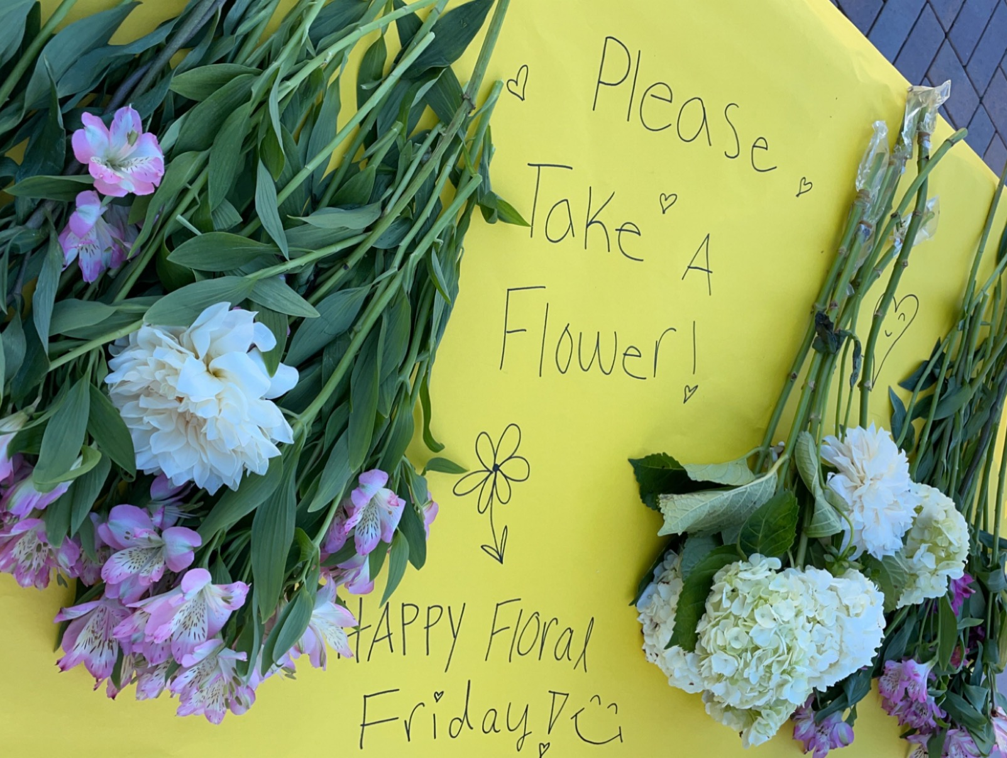
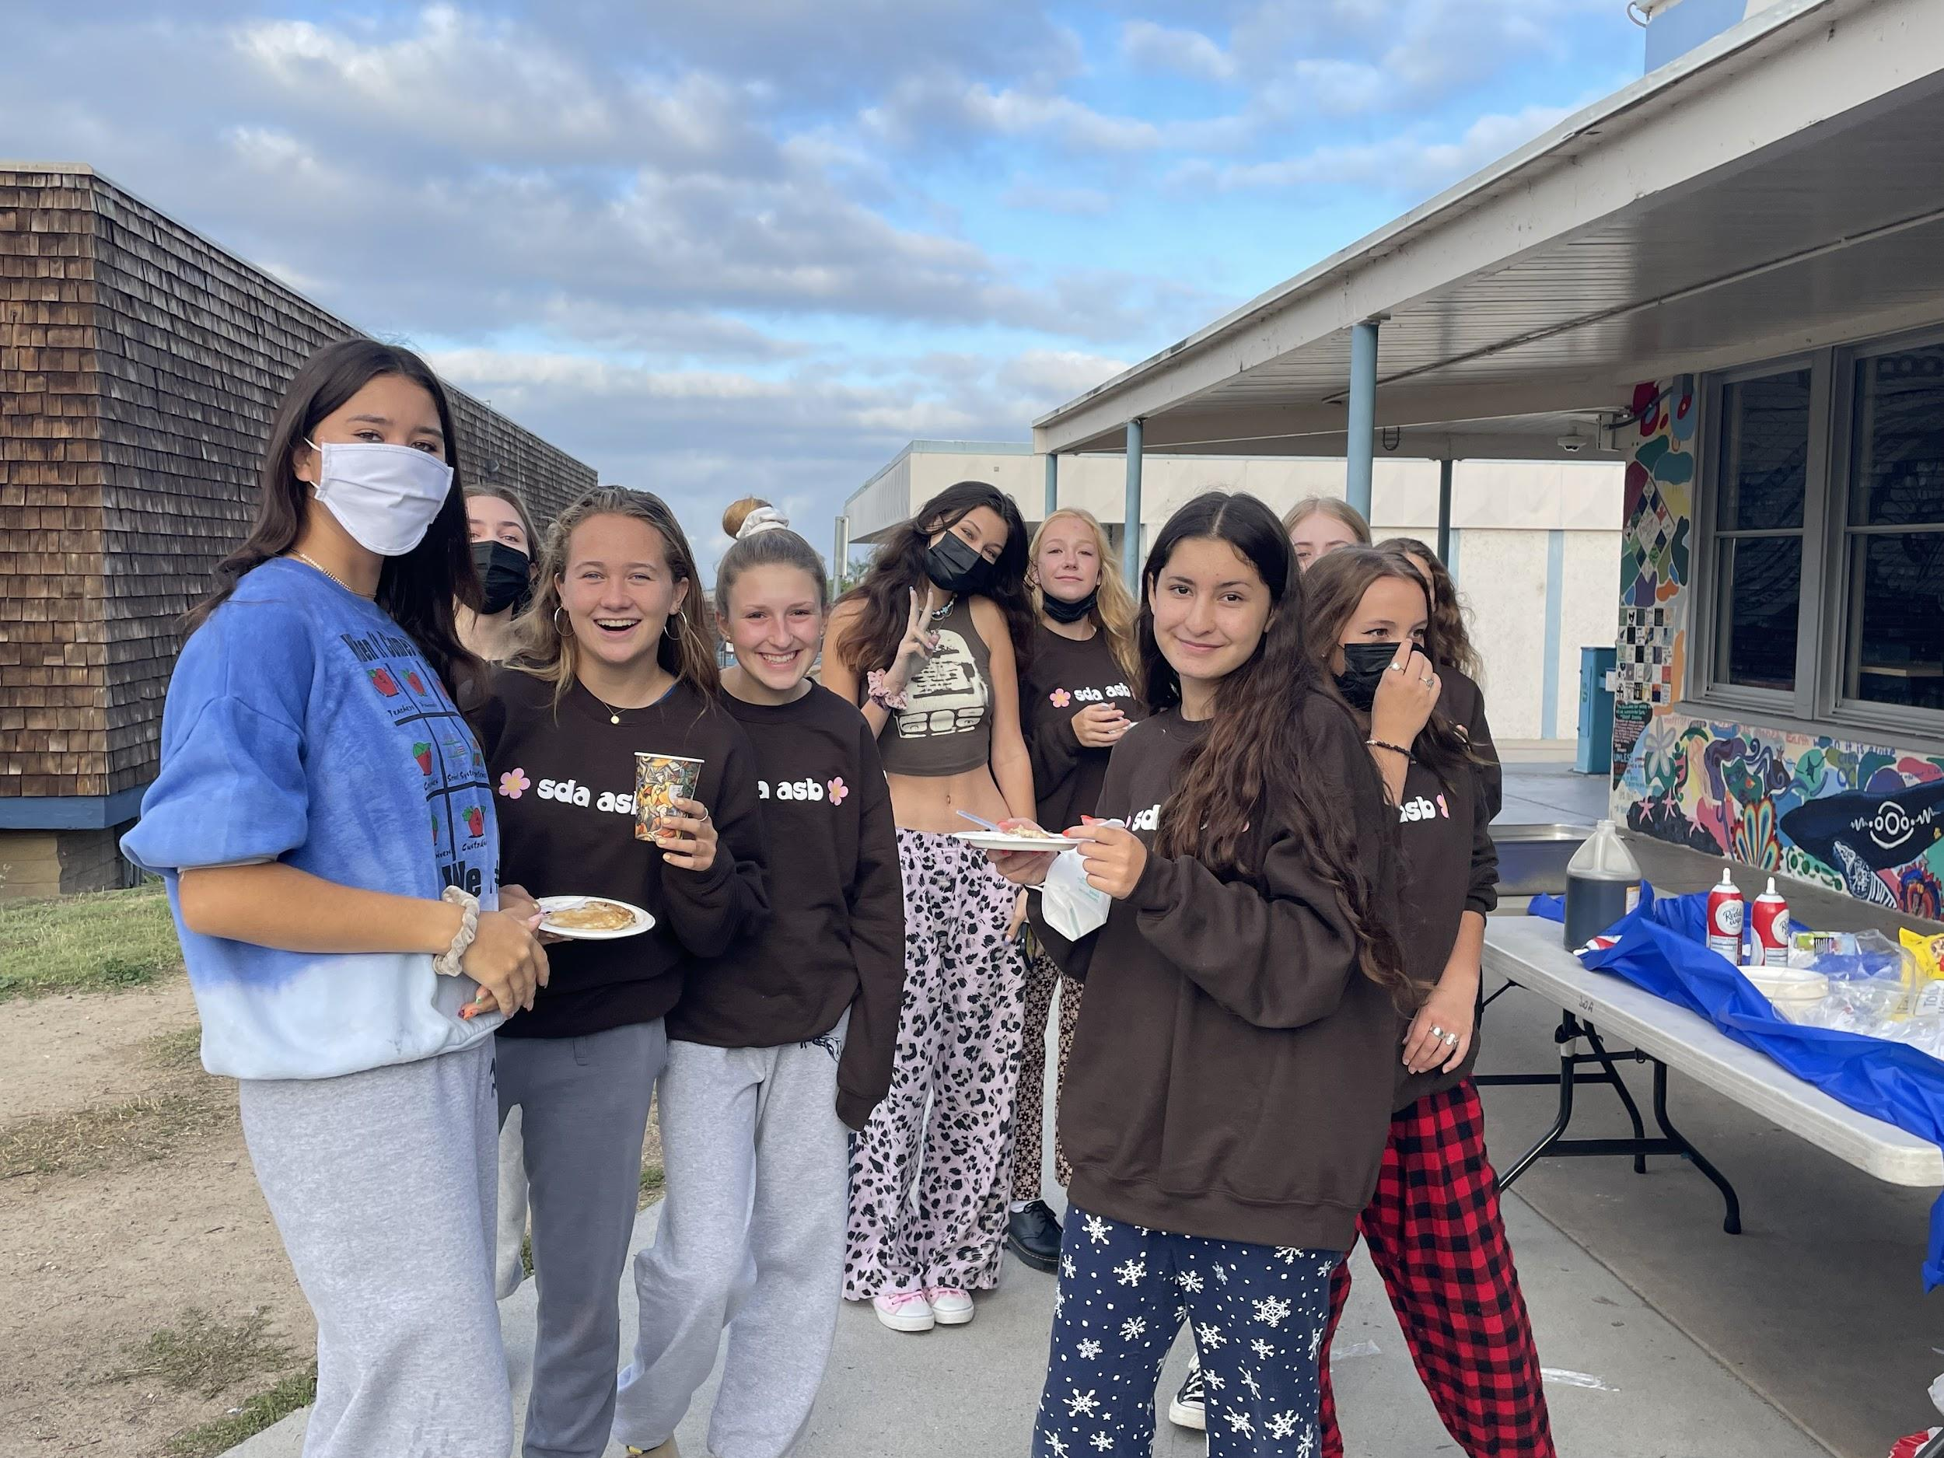
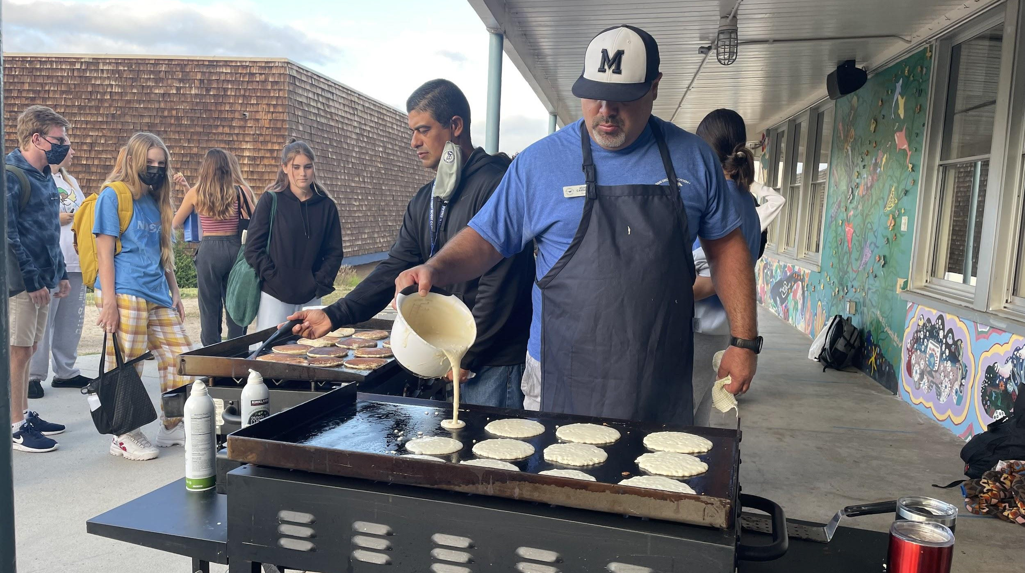
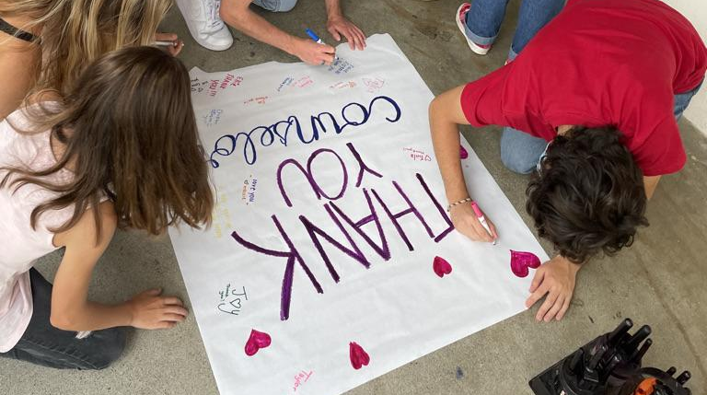
ASBs Mental Health Initiative + Wellness Wednesdays
Purpose + What we do
Create student body and staff accessible events that promote mental well-being
Support mental wellness groups like NAMI and Pals by providing materials and promotions
Relay information about current resources that the student body are not aware about to help bridge communication gaps

Slide 5
SDUHSD Mental Health Initiative Goals
School site resources
Mental Health Slideshow
District wide equity
Existing resources & how to relay those resources to the student body (like todays presentation)
Slideshow contains all the mental health related activities and resources available in the district. It also shows which schools lacks or do not has certain mental health resources
Ensure that each school in our school district has equitable access to resources meeting students needs
Notes:
Through undergoing a comprehensive review of mental health resources within the SDUHSD school district’s high schools, we are advocating for reforms and increased attention to the subject of mental health. Furthermore, we want to level the playing field for all high schools to ensure each has equal opportunity and access to support.
PALS
LGBTQIA+ Support Group
School Culture Celebration
Yellow Ribbon Week/ Red Ribbon Week
Teacher Check-Ins During Class

Slide 6
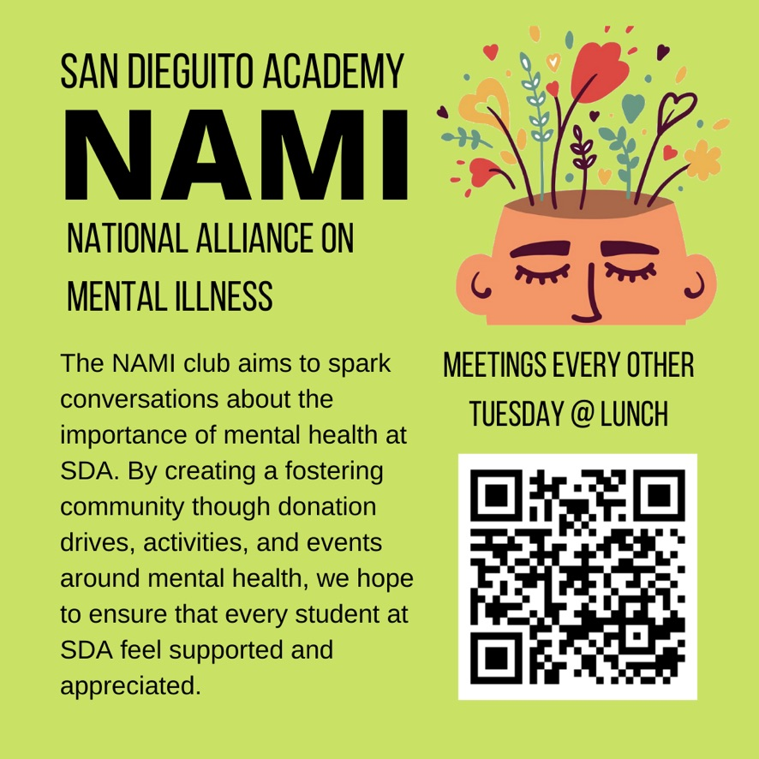
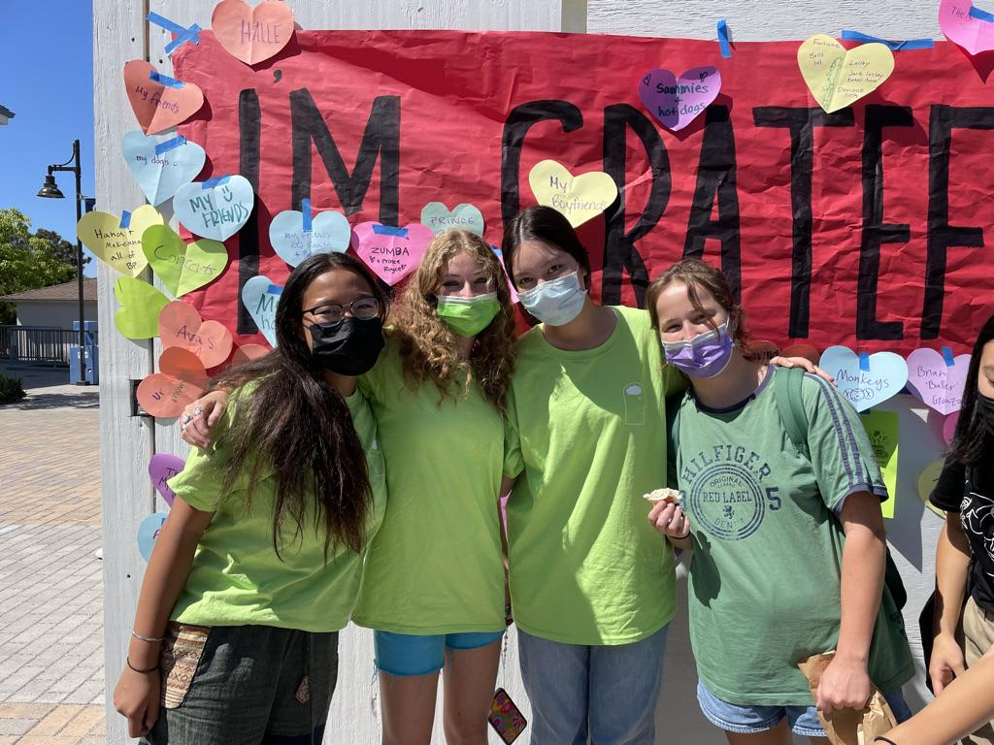
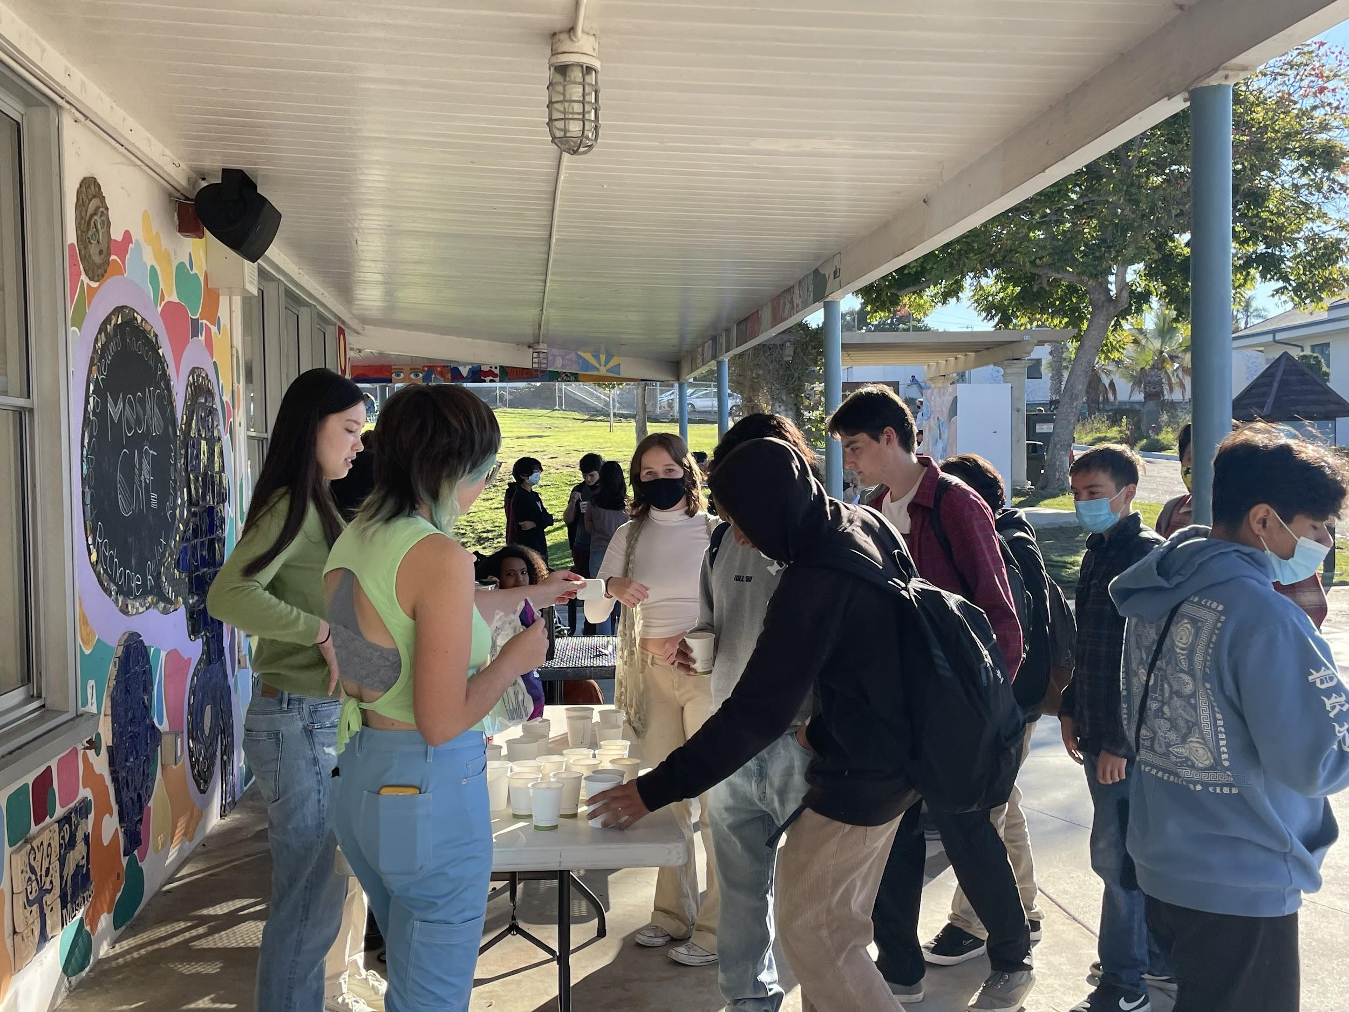
NAMI Club
(National Alliance on Mental Illness)
Purpose + What we do
The NAMI club aims to spark conversations about the importance of mental health at SDA. By creating a fostering community through donation drives, activities, and events around mental health, we hope to ensure that every student at SDA feels supported.
Recent Events
Gratitude Wall
Self-Care Stands
Sock Drive
Guest Speakers
Mental Health Movies
Student easy accesable events
Notes:
Selina feel free do edit or make this a more bullet pointed slide

Slide 7
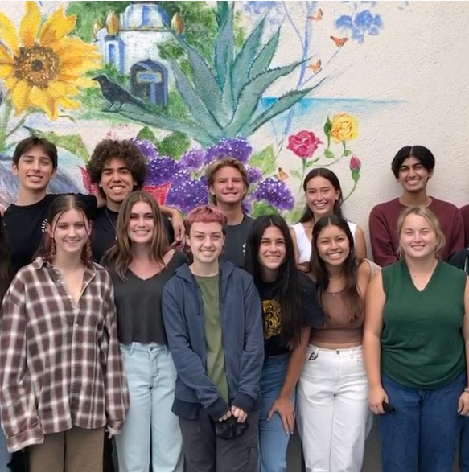
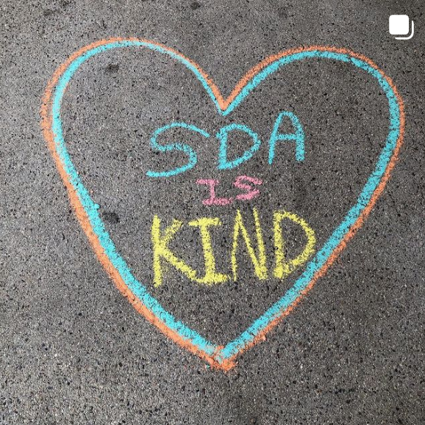
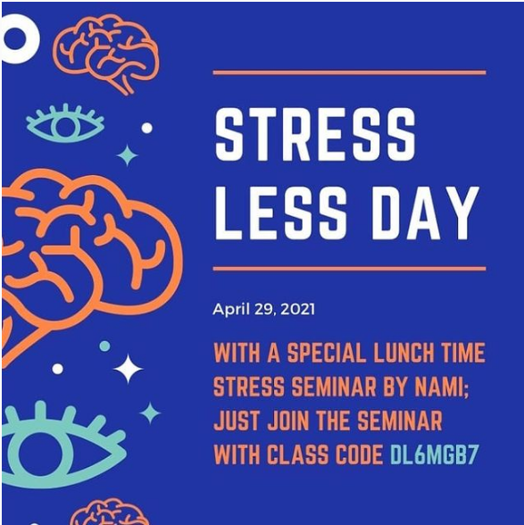
PALS
Purpose + What we do
Provide a place for students to go to during classes and lunch to talk to someone
PALs are trained by counselors and professionals in the industry
We also do class presentations about important topics like healthy relationships, stress, and more

Slide 8
What Our Next Steps Are...
Video
Toolkit
We are partnering with Pals, NAMI, ASB, and our counselors to film an in depth overlay about the mental health resources available for students on our campus
How to start the conversation of mental health in your classrooms with available activities, check in questions, and resources for teachers to utilize

Slide 9
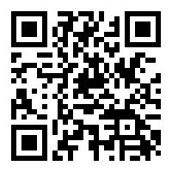
Moving forward
Video
Once the mental health resources video is published and finalized we asked that you show it during your homeroom and or period of your choice to help bridge communication gaps to the student body.
Many mental health resources available to students but are sadly not well known.
Toolkit
Please fill out this google form to help us draft our Toolkit for a mental health activity that is easy and understandable for teachers to conduct.

Slide 10
Thank you!
Have any question comments or concerns? Please feel free to reach out to via email or ASB!
Nitin Chatlani, Ethan Fitzgerald, Selina Oien, Joy Ruppert

